Slide 1


Company Analysis 2018

Slide 2
Agenda
Analyze 2018 Data
Examine Strategies For 2019
Make Recommendations

Slide 3
2018 Analysis
Total Yearly Profit($)
$39,227,776
Total Yearly Profit(%)
54.4%

Slide 4

Possible Strategies For 2019

Slide 5
Strategy 1
Remove 10 worst selling cars from combined fleet, Add 10 more top selling cars to combined fleet
.2%
Increase Over 2018

Slide 6
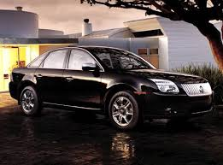
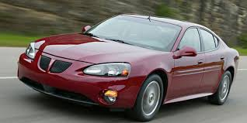
Strategy 2
Strategy 2: Decrease insurance cost by 15%(by removing accident prone cars), increase rental price by 20%.
Save $724,000
Over 2018
Add > $14M
Over 2018

Slide 7
Combined Strategy
Combined Strategy: Combines the best elements from Strategy 1 and 2 to achieve the best profit margin.

Slide 8
Results
9.8% Profit Increase From 2018
Or
$18M Profit Increase From 2018

Slide 9
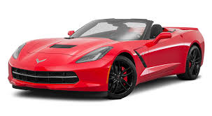
Q & A

